Slide 1
Reasoning Failure Boundaries in ECG Foundation Models Under Progressive Physiological Information Loss
First Review
Vijay K (3122235001157)
Siddharth Chandrasekar S (3122235001310) Vedanth M S (3122235001314)
Guided by: Dr. Anusha Jayasimhan, Assistant Professor Department of Computer Science and Engineering
SSN College of Engineering
Academic Year 2026–2027

Slide 2






Presentation Outline
1
Introduction
2 Literature Review
System Design
4 Implementation and Results Project Management
3
5
6 Conclusion
Short Project Title

Slide 3
Background and Motivation
ECG models can reason well when the full physiological picture is available
But as leads disappear, the evidence available to support that reasoning also disappears
The model may still produce a plausible answer even when its physiological evidence is becoming insufficient
Can structured clinical knowledge help preserve grounded reasoning without replacing the missing evidence?
Core Motivation
To understand when ECG reasoning stops being trustworthy as physiological evidence disappears. And to see whether clinical knowledge can help preserve that reasoning for longer.
Short Project Title

Slide 4
Problem Statement
Problem
Current ECG evaluation does not characterize the degradation of evidence-grounded clinical reasoning as physiological information decreases.
Clinical reasoning is not evaluated across progressive levels of ECG information.
Lead loss removes physiological evidence needed to support clinical reasoning.
Accuracy-based and partial-lead evaluations measure whether the model remains correct, but not whether its reasoning remains grounded in the evidence still available.
The evaluation must preserve controlled information loss, prevent reconstruction of missing evidence, and distinguish clinically supported reasoning from unsupported inference.
Short Project Title

Slide 5
Project Objectives
1
To establish a controlled framework for evaluating ECG clinical reasoning under progressive physiological information loss.
To compare ECG-only reasoning with Clinical Knowledge Prior (CKP)-assisted reasoning under identical information-loss conditions.
To evaluate whether clinical reasoning remains grounded in the physiological evidence available at each level of information loss.
To characterize the Reasoning Degradation Curve (RDC) by measuring grounding quality and diagnostic performance under progressive ECG lead masking.
To determine the Reasoning Failure Boundary (RFB) and assess whether CKP can delay this boundary without increasing unsupported clinical inference.
2
3
4
5
Short Project Title

Slide 6
Scope and Expected Outcomes
Included
Excluded / Constraints
Target users and use cases: ECG-AI researchers and clinical AI system designers evaluating reasoning under incomplete ECG information.
Core modules: ECG foundation-model adaptation,
hypothesis preparation, CKP-assisted reasoning, and evidence grounding.
Datasets: PTB-XL, MIMIC-IV-ECG
and Chapman Shaoxing
Evaluation: Reasoning Degradation Curve, AURDC, and RFB.
Features outside current phase: Lead reconstruction, new foundation-model development, and non-ECG reasoning tasks.
Dataset and hardware constraints: Disease selection depends on dataset coverage and training on available compute resources.
Dependencies: Requires pretrained models, clinical evidence, and CKP construction.
Deployment boundaries: Limited to research benchmarking.
Short Project Title

Slide 7
Literature Review
Ref.
Method / Technology
Key Contribution
Limitation / Research Gap
[1]
Strodthoff et al. (2021) — PTB-XL
Benchmark
K-MERL (2025) —
Arbitrary-Lead ECG
Standardizes ECG model evaluation.
Enables ECG representation learning with arbitrary leads. Provides strong pretrained ECG representations and benchmarking.
Links ECG findings
to measurable evidence for grounded reasoning.
Does not evaluate reasoning under progressive lead loss.
[2]
Does not evaluate grounding during progressive lead loss.
[3]
ECG-FM (2025) —
ECG Foundation Model
GEM (2025) —
Grounded ECG Understanding
Does not evaluate grounded reasoning under progressive lead loss.
[4]
Does not study grounding degradation under progressive lead loss.
Short Project Title

Slide 8
Research Gap and Proposed Contribution
Identified Gap
Proposed Contribution
Reasoning is rarely evaluated under progressive physiological information loss.
The point at which ECG diagnosis becomes unreliable due to insufficient evidence remains unclear.
The role of structured knowledge in delaying this failure is unexplored.
A controlled framework for progressive ECG information loss.
ECG-only vs. CKP-assisted reasoning comparison.
Area under Reasoning Degradation Curve (AURDC) and Reasoning Failure Boundary.
Short Project Title

Slide 9
Existing System vs. Proposed System
Criterion
Existing System
Proposed System
Approach
Accuracy / Quality Cost / Time Security / Privacy
Evaluates ECG models under fixed or predefined input conditions.
Focuses mainly on getting the diag-nosis correct.
Requires conventional model evalu-
ation at selected input conditions. Operates within existing clinical-data access constraints.
Generally evaluates fixed lead con-figurations.
Evaluates reasoning across progres-sively reduced ECG information.
Evaluates diagnosis correctness and reasoning grounding.
Requires repeated evaluation across
information-loss levels.
Maintains the same data-access boundaries without additional data collection.
Scalability
Supports systematic evaluation
from 12 to 1 available leads.
Short Project Title

Slide 10
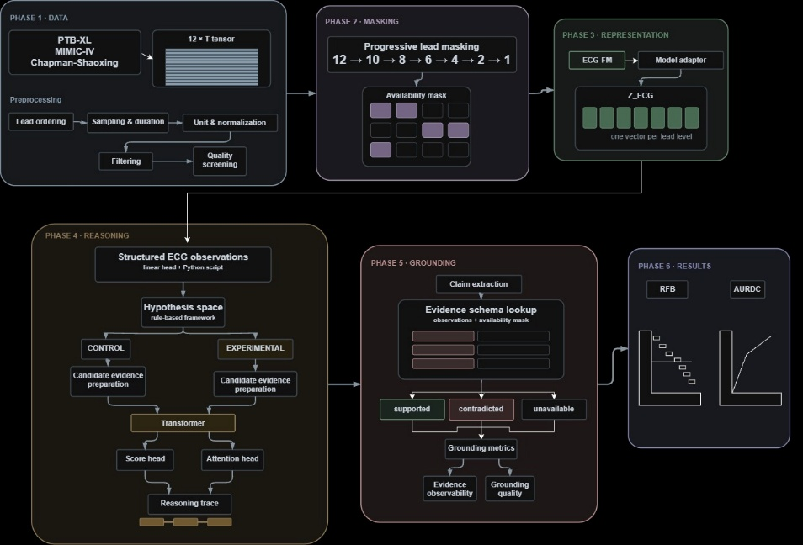
Proposed System Architecture
Short Project Title
Figure 1: Phase 4 & P
5 End-to-End System Architecturehase

Slide 11
System Modules
1
Module 1 – Data & Preparation: Loads and standardises ECG data and prepares the 12-lead input with lead-availability masks.
Module 2 – Controlled Degradation: Progressively masks ECG leads from 12 to 1 using lead-availability masks without reconstruction.
Module 3 – Representation & Observation: Uses the selected ECG foundation model and Model Adapter to obtain standardised ECG representations and structured ECG observations.
Module 4 – Reasoning: Builds the hypothesis space and candidate evidence, then performs ECG-only and CKP-assisted reasoning using the trainable Transformer.
Module 5 – Grounding: Maps the generated reasoning claims to the Evidence Schema and verifies them against the available ECG evidence.
Module 6 – Evaluation & RFB: Measures Grounding Quality and diagnostic performance, constructs the Reasoning Degradation Curve, and derives AURDC and the Reasoning Failure Boundary (RFB).
2
3
4
5
6
Short Project Title

Slide 12
Methodology / Workflow
Data Preparation
ECG Preprocessing & Lead Masking Foundation Model & Representation Hypothesis & CKP-Assisted Reasoning Claim Grounding & Verification Degradation Analysis & RFB
1
Evaluation Metrics
2
3
Grounding Quality
Reasoning degradation Curve
Reasoning Failure Boundary
Area Under the Reasoning Degradation Curve (AURDC)
4
5
6
Short Project Title

Slide 13
Core Algorithm / Processing Logic
Algorithm: Clinical Knowledge Prior Construction
Obtain ECG-relevant concepts from SNOMED-CT.
Identify ECG findings and their associated clinical relationships.
Organise concepts, findings, and relationships into an ECG-specific knowledge structure.
Define evidence-to-disease relationships and verification rules. Construct the ECG-specific Clinical Knowledge Prior (CKP). Retrieve candidate-relevant CKP concepts during reasoning.
1
2
3
4
5
6
Short Project Title

Slide 14
Technology Stack and Resources
Category
Selected Technology / Resource
Language & Libraries Framework
Pre-built ECG Tools Database
Dataset
Development Tools Hardware
Python, NumPy, SciPy, Pandas PyTorch / Hugging Face Transformers
WFDB, NeuroKit2, ECG preprocessing and signal-processing utilities Not required
PTB-XL, MIMIC-IV-ECG, Chapman-Shaoxing, SNOMED-CT
Jupyter / VS Code, Git, GPU-enabled environment GPU-enabled system, sufficient RAM and storage
Short Project Title

Slide 15
Implementation Status
Component | Status | Evidence / Remarks
Requirements and Design | Completed | Objectives, scope, and architecture de-
Datasets & Input Preparation | Planned | fined Datasets and SNOMED-CT identified
Data Preprocessing | Planned | ECG standardisation and preprocess-
Reasoning & CKP Framework | Planned | ing ECG-only and CKP paths defined
Grounding & Evaluation | Planned | Grounding, AURDC, and RFB defined
Testing | Planned | Module and integrated testing
Documentation | In Progress | Report and technical documentation
Short Project Title

Slide 16
Testing and Validation
Test ID Test Scenario
Expected Result
Status
TC-01
TC-02 TC-03
TC-04 TC-05
TC-06
Progressive Lead Masking
ECG-only vs. CKP Reasoning Grounding Verification
CKP Relevance Control Reasoning Failure Boundary
Degradation Analysis
Generates 12–1 lead inputs without re-construction.
Compares both paths under the same
masking levels.
Verifies claims using available or deriv-able ECG evidence.
Compares relevant and irrelevant CKP.
Identifies the unreliable reasoning lead level.
Computes the degradation curve, AU-
RDC, and RFB.
Planned
Planned Planned
Planned Planned
Planned
Validation Method
Component Validation: Each module produces outputs matching its defined input–output criteria.
Integration Testing: The complete ECG-to-grounding pipeline executes correctly without data-flow errors. Statistical Validation: CKP-assisted performance is significantly compared with ECG-only across masking levels. Cross-Dataset Validation: The framework maintains consistent evaluation trends across independent ECG datasets.
Short Project Title

Slide 17
Project Timeline
Activity
Jul Aug Sep Oct Nov Dec Jan Feb Mar Apr May
Literature review (VMS) Dataset Preprocessing (SCS)
CKP construction (VMS)
ECG Pipeline & Model Adaptation (SCS) Reasoning & Grounding Design (VK)
Metrics & Evaluation
Setup (VK)
Integrated Pipeline & Debugging
Validation
Testing Documentation
Short Project Title

Slide 18
Team Responsibilities
Team Member
Responsibilities
Current Status
Vedanth M S
Siddharth S Vijay K
All Members
Literature review, CKP design, methodology, presen-tation
Dataset preparation, preprocessing, lead masking, ECG model and representation
Reasoning pipeline, grounding, evaluation metrics,
experiments and analysis Validation, Testing, Documentation
In Progress
Planned Planned Planned
Short Project Title

Slide 19
Challenges, Risks, and Mitigation
Risk / Challenge Possible Impact
Mitigation
Derived ECG lead handling complexity
CKP construction complexity
Incorrect evidence availability assessment
Limited benefit or unsupported knowledge influence
Incorrect claim verification or candidate selection
Track direct and derivable ECG evidence using lead rela-tionships
Use ECG-relevant con-
cepts and relationships from SNOMED-CT
Define standardized evidence rules and controlled hypothe-sis generation
Use standardized preprocess-
Evidence Schema & hypothe-sis space complexity
Dataset variability Integration complexity Computational resource
Inconsistent datasets Schedule delay
results across
ing and external validation Develop and test modules in-dependently before integration Optimize inference and use GPU-based resources
Longer experimental execution
Short Project Title

Slide 20
Conclusion and Future Work
Conclusion
Problem: How does ECG reasoning degrade as physiological evidence is lost? Approach: Compare ECG-only and CKP-assisted reasoning under progressive lead masking.
Current work: Framework, datasets, CKP, and grounding approach established. Evaluation: Measure grounding quality and diagnostic performance across lead levels. Outcome: Compute AURDC and identify the Reasoning Failure Boundary (RFB).
Broaden disease coverage: Evaluate more ECG conditions and categories.
Expand validation: Test across more datasets and diverse patient populations.
Improve CKP coverage: Add more ECG findings, relationships, and evidence rules.
Extend degradation analysis: Study finer-grained and alternative lead-masking patterns.
Future Work
Short Project Title

Slide 21
References I
N. Strodthoff, P. Wagner, T. Schaeffter, and W. Samek, “Deep Learning for ECG Analysis: Benchmarks and Insights from PTB-XL,” IEEE Journal of Biomedical and Health Informatics, vol. 25, no. 5, pp. 1519–1528, 2021.
https://doi.org/10.1109/JBHI.2020.3022989
C. Liu, C. Ouyang, Z. Wan, H. Wang, W. Bai, and R. Arcucci, “Knowledge-enhanced Multimodal ECG Representation Learning with Arbitrary-Lead Inputs,” Findings of the Association for Computational Linguistics: EMNLP 2025, pp. 7298–7316, 2025. https://aclanthology.org/2025.findings-emnlp.385/
K. McKeen, S. Masood, A. Toma, B. Rubin, and B. Wang, “ECG-FM: An Open Electrocardiogram Foundation Model,” JAMIA Open, vol. 8, no. 5, Art. ooaf122, 2025. https://doi.org/10.1093/jamiaopen/ooaf122
X. Lan, F. Wu, K. He, Q. Zhao, S. Hong, and M. Feng, “GEM: Empowering MLLM for Grounded ECG Understanding with Time Series and Images,” Advances in Neural Information Processing Systems (NeurIPS 2025), vol. 38, 2025.
https://openreview.net/forum?id=7MZc0QJ3d4
Short Project Title

Slide 22
Thank You
Questions and Discussion
Contact: vijay2310785@ssn.edu.in

